Slide 1

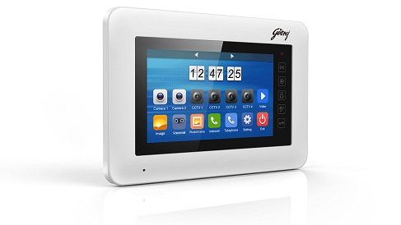
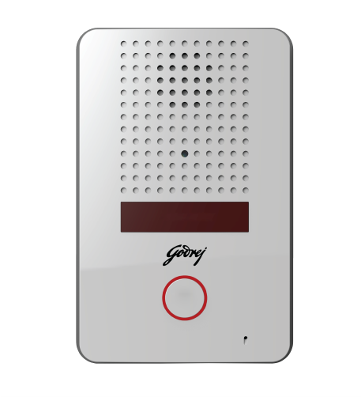

SEETHRU 7 Color Hands-free VDP

Slide 2



I” don’t want to walk to the indoor unit to view video.”
Can be connected to a TV
“I need retrievable images and videos”
Supports removable SD card .
Consumer profile
HH income 10 Lacs & above
Style conscious,
Working Professionals, Nuclear Families
Tech Savvy, Mobile
Builders
“I need multiple indoor units”
Supports 3 indoor unit
“I don’t know who had come to visit me when I’m away.”
In built memory to store video,
I can talk in real-time with my visitor
Certified

Slide 3
Feature | Benefit to the Customer
7” Indoor Screen option | Clear and Crisp images to help better identification and recognition of the visitor
Supports Upto 2 Outdoor Unit | Dual Tier Security Level – One at Gate entry, second at main door entry. Suitable for multi-entrance villa.
Supports 4 CCTV Cameras | Monitor critical area of the house. -Store Room, Balcony, Back Door, Garage / car park, Boundary Wall etc from the comforts of the home.
Supports 3 Indoor Monitors | Answer visitor call form anywhere in the house. Extend monitoring capability to Study Room, Kitchen, Bedroom etc
Supports SD to capture photographs and record videos | View, Copy, e-mail, manage visitor photographs and video clip using SD card

Slide 4
Feature | Benefit to the Customer
Call Forward using Landline Telephone | Forward calls from the outdoor station to your mobile phone using landline connection. Talk to the visitor on real-time basis when you are away. Supports remote unlocking of the electronic lock.
Supports T.V Out | View Outdoor Station / CCTV video feed on Television at a flip of a channel, without walking down to the indoor unit.

Slide 5
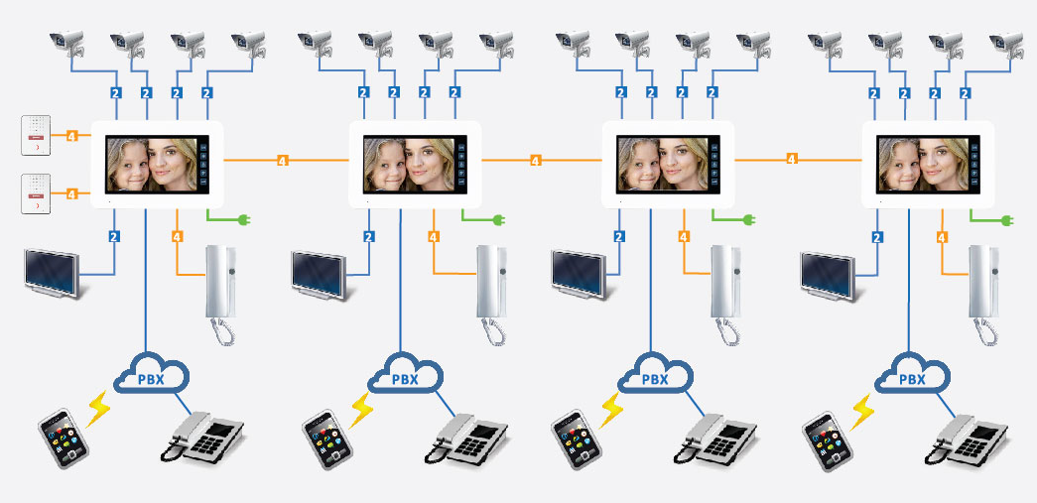
System Diagram

Slide 6
SEETHRU 7” Color Hands-free VDP

